Slide 1
ISP152 – Topic 2: Principles of Information Security
2.1 Introduction
2.2 Confidentiality, integrity and availability
2.3 Identification, authentication, authorisation and access control
2.4 Auditing, accountability and legal/regulatory compliance

Slide 2
Module Outcomes
Demonstrate an understanding of the Open Systems Interconnection (OSI) model and common network architectures.
Identify the key hardware and software components found in computer networks.
Participate in the implementation of the basic principles that underpin the protection of information assets (identification, authentication, etc).
Identify the different stages of the operations security process, and the activities that occur within each stage.
Identify common threats affecting information security at the human level, the physical level, the network level and the application level; and outline preventative measures that can be used to eliminate or manage these threats.

Slide 3
(2.1) Introduction
In this topic, you will gain knowledge in the following areas:
2.2 Confidentiality, integrity and availability
2.3 Identification, authentication, authorisation and access control
2.4 Auditing, accountability and legal/regulatory compliance

Slide 4
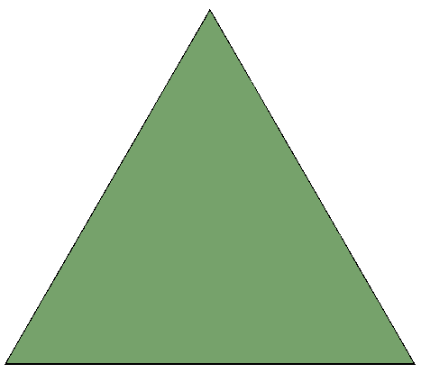
(2.2) Confidentiality, integrity and availability
2.2.1 The CIA Triad
CIA Triad: Core principles of information security
Confidentiality: Prevent unauthorised access to data using passwords, PINs, and secure storage
Integrity: Protect data from unauthorised changes with access controls and read/write restrictions
Availability: Ensure data is accessible when needed; threats include power failures or cyberattacks like DoS

Slide 5

(2.2) Confidentiality, integrity and availability
2.2.2 The Parkerian Hexad
Expands the CIA Triad with Possession, Authenticity, Utility
Integrity (Parker): Data must remain completely unchanged from its original state
Possession: Physical control of data storage; loss means loss of data access
Authenticity: Ability to verify the source of information (e.g. email origin)
Utility: The usefulness or value of data, measured by degree (not just yes/no)

Slide 6
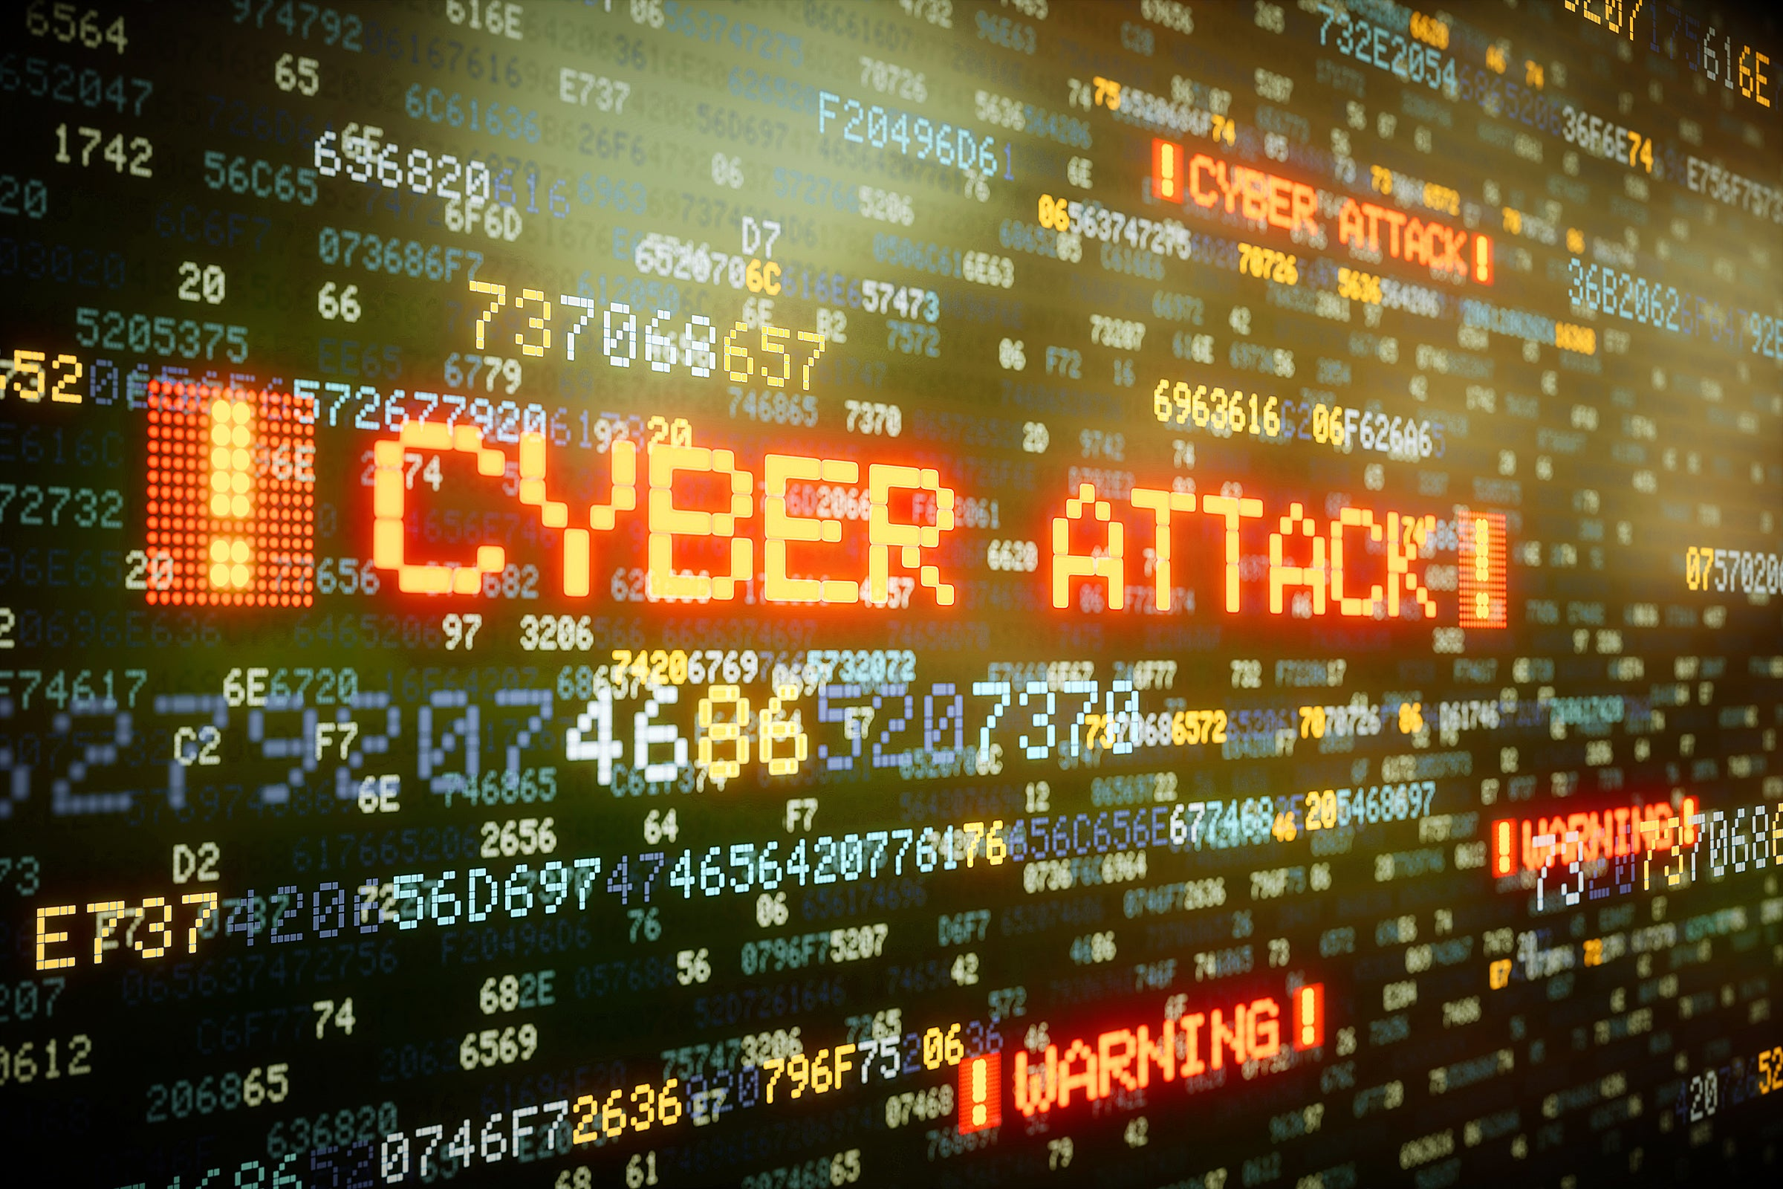
(2.2) Confidentiality, integrity and availability
2.2.3 Security attacks
Security Attacks target data at rest or data in motion
Interception: Unauthorised access to data or apps; often hard to detect
Interruption: Disrupts user access; impacts data integrity and availability
Modification: Unauthorised changes to data; compromises CIA principles
Fabrication: Creates fake data or processes; affects system integrity and availability

Slide 7
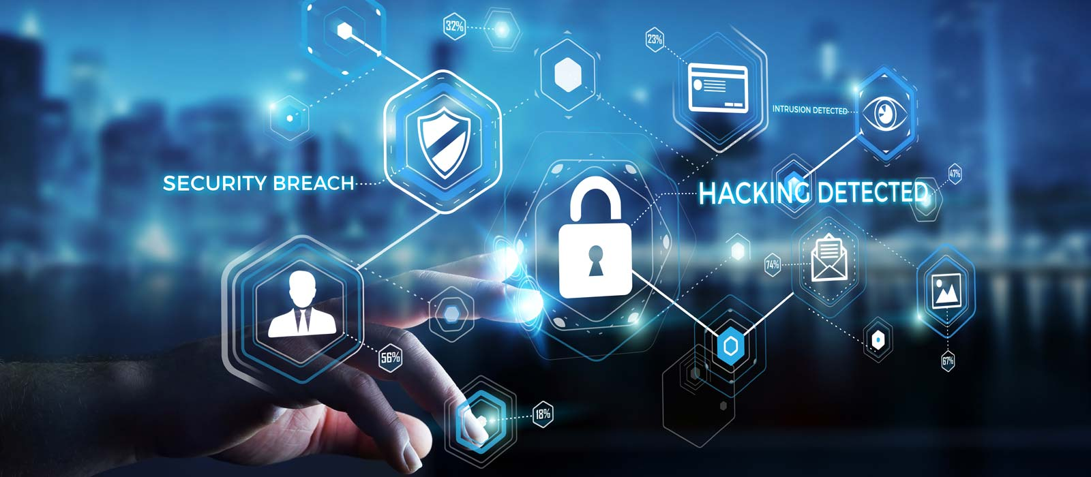
(2.2) Confidentiality, integrity and availability
2.2.4 Threats, vulnerabilities and risk
Threat: Potential action that can harm systems, data, or processes
Vulnerability: Weakness in hardware/software that can be exploited
Risk: Likelihood of harm when both a threat and vulnerability exist
Impact: Measures the potential damage based on asset value

Slide 8
(2.2) Confidentiality, integrity and availability
Activity
Study the following article:
Title: What is the difference between a threat, a vulnerability, and a risk?
Link:https://www.sectigo.com/resource-library/what-is-the-difference-between-a-threat-a-vulnerability-and-a-risk
Time allocation: 10 minutes

Slide 9

(2.2) Confidentiality, integrity and availability
2.2.5 Risk management
Step 1: Identify key assets and their role in business functions
Step 2: Identify threats using models like CIA Triad or Parkerian Hexad
Step 3: Identify vulnerabilities linked to those threats
Step 4: Assess risks by matching threats to vulnerabilities
Step 5: Mitigate risks with physical, technical, or administrative controls

Slide 10
(2.2) Confidentiality, integrity and availability
2.2.6 Incident response
Incident Response Plan: Prepares steps to follow after a security breach
Stage 1 – Preparation: Create/update policies and procedures
Stage 2 – Detection & Analysis: Identify breach, assess severity, decide response
Stage 3 – Containment, Eradication, Recovery: Limit damage, remove threat, restore data
Stage 4 – Post-Incident: Analyse cause, improve future defences
Defence in Depth: Layered protection for network, host, apps, and data

Slide 11
(2.2) Confidentiality, integrity and availability
Activity
Identify a personal ‘business asset’ such as a smartphone or laptop. Write notes outlining how threats, vulnerabilities and risks could affect this asset and suggest ways in which the impact of those threats, vulnerabilities and risks could be addressed.
Time allocation: 10 minutes

Slide 12

(2.3) Identification, authentication, authorisation and access control
2.3.1 Identification and authentication
Identification alone is unreliable: IDs and emails can be forged
Verification: Confirms identity claim (e.g. through a third party), but not foolproof
Identity theft: Often based on false information; a growing threat
Authentication factors: Range from PINs to biometrics (e.g. fingerprints)
Multifactor Authentication: Combines two or more factors for stronger security
Mutual Authentication: Client and server verify each other’s identity

Slide 13
(2.3) Identification, authentication, authorisation and access control
Activity
Watch the following video:
Title: What is Multifactor Authentication (MFA)?
Link: https://www.youtube.com/watch?v=_3rlQVXGKZc
Time allocation: 02:30

Slide 14

(2.3) Identification, authentication, authorisation and access control
Common methods: Passwords, biometrics, hardware tokens
Passwords: Strong if complex, unique, and securely managed
Biometrics: Verifies physical traits (e.g. fingerprint) against stored data
Hardware Tokens: USB devices with unique IDs for secure access

Slide 15
(2.3) Identification, authentication, authorisation and access control
Activity
Study the following article:
Title: How identification, authentication, and authorization differ.
Link:https://www.kaspersky.com/blog/identification-authentication-authorization-difference/37143/
Time allocation: 15 minutes

Slide 16
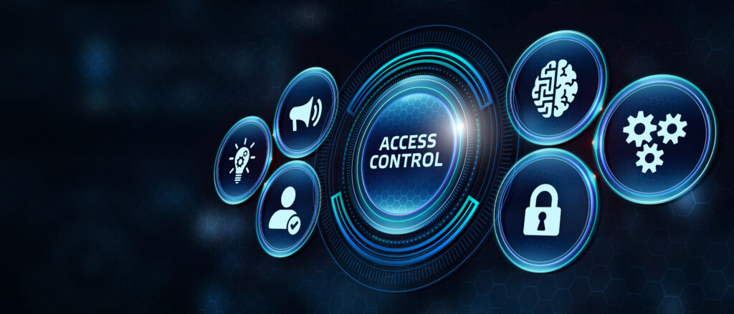
(2.3) Identification, authentication, authorisation and access control
2.3.2 Authorisation and access controls
Authorisation: Determines what an authenticated user is allowed to do
Access Controls: Manage access to systems, tools, and resources
Physical: Keys, access cards, barriers
Logical: Passwords, software permissions
Access Control Lists (ACLs): Define user permissions for files, systems, and networks
Token-based Access: Physical/logical tokens grant defined access rights

Slide 17
(2.3) Identification, authentication, authorisation and access control
2.3.2 Authorisation and access controls
Logical Access Control Models:
DAC: Resource owner sets permissions
MAC: Central authority grants access
Rule-Based: Admin-defined rules determine access
Role-Based (RBAC): Access tied to user roles (e.g. sales vs. finance)
Attribute-Based (ABAC): Access based on user, system, or environment attributes
Multi-Level: Combines models for high-security needs

Slide 18

(2.3) Identification, authentication, authorisation and access control
2.3.2 Authorisation and access controls
Security Consideration:
Tailgating: Unauthorised person follows a legit user into a secure area
Complex systems (e.g. airports) may require multiple forms of access proof

Slide 19
(2.3) Identification, authentication, authorisation and access control
Activity
Identify three different examples of access controls that exist within your home and/or work environment. For each access control example, write down its purpose, evaluate its effectiveness, and make a note of any additional measures that could be taken to increase the level of security that it provides.
Time allocation: 15 minutes

Slide 20
(2.4) Auditing, accountability and legal/regulatory compliance
2.4.1 Accountability
Accountability: Users must be responsible for their actions and follow access rules
Non-repudiation: Ensures actions can be traced to a specific individual
Deterrence: Monitoring discourages misuse of resources
Intrusion Detection/Prevention: Tools that detect and alert on suspicious activity
Chain of Custody: Ensures evidence remains intact and unaltered
Tracking System: Monitors, records, and reports evidence handling for legal use

Slide 21
(2.4) Auditing, accountability and legal/regulatory compliance
Activity
Watch the following video:
Title: How To Prevent a Security Breach in Your Business.
Link: https://www.youtube.com/watch?v=ZEl1SEa5hhA
Time allocation: 05:10

Slide 22
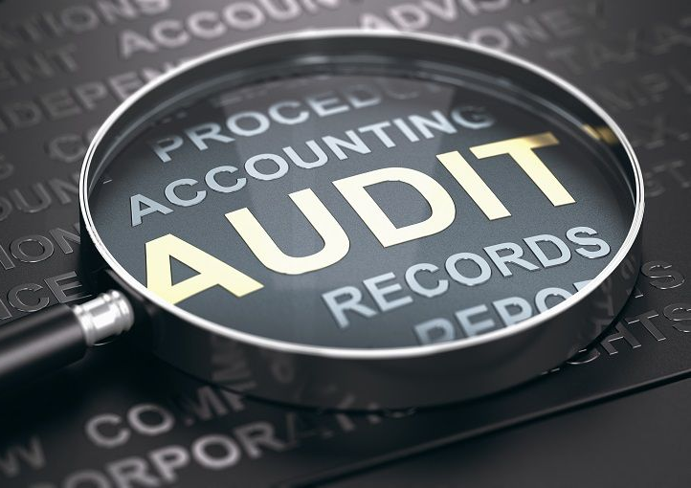
(2.4) Auditing, accountability and legal/regulatory compliance
2.4.2 Auditing
Internal Auditing: Reviews compliance with rules on resource use
External Audits: Ensure compliance with financial and legal regulations
Audit Types: May include software licenses and employee web usage
Computer Logs: Record system activity history
Monitoring: Reviews logs to detect unusual behaviour or traffic
Assessment Audits: Identify and address system vulnerabilities

Slide 23
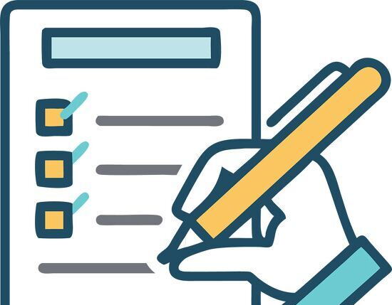
(2.4) Auditing, accountability and legal/regulatory compliance
2.4.3 Regulatory compliance
Compliance: Adherence to laws and industry standards; a business requirement
Regulatory Compliance: Follows legally mandated rules; verified through audits
Industry Compliance: Follows non-legal but essential standards (e.g. credit card processing)
Types of Controls:
Physical: Prevent access (e.g. cameras, locks)
Administrative: Policies and procedures to reduce risk
Technical: Tools like firewalls and intrusion detection systems

Slide 24
(2.4) Auditing, accountability and legal/regulatory compliance
Control Types:
Key Controls: Critical; their failure affects entire processes
Compensating Controls: Substitutes when key controls aren't feasible
Compliance Process:
Monitor controls
Review effectiveness
Document and analyse
Report findings

Slide 25
(2.4) Auditing, accountability and legal/regulatory compliance
Activity
Watch the following video:
Title: Why good compliance equals good business.
Link: https://www.youtube.com/watch?v=MlKWd84TuzI
Time allocation: 05:07

Slide 26

(2.4) Auditing, accountability and legal/regulatory compliance
2.4.4 Legal compliance
Legislation guides compliance with standards and practices
NIST (USA): Sets security standards often adopted into law
SOX (2002): Regulates financial and electronic record-keeping — relevant to SA public companies
GDPR (2018): Applies to any organisation collecting EU citizen data, regardless of location
Global operations require awareness of international laws and regulations

Slide 27
(2.4) Auditing, accountability and legal/regulatory compliance
Activity
Watch the following video:
Title: The Fall of Enron - Sherron Watkins.
Link: https://www.youtube.com/watch?v=v26mGyNyDpE
Time allocation: 04:13

Slide 28
(2.4) Auditing, accountability and legal/regulatory compliance
Compliance Frameworks: Help manage multiple regulations and simplify audits
ISO Standards:
ISO/IEC 27000: Info security overview and terms
ISO/IEC 27001: Requirements for security management systems
ISO/IEC 27002: Best practices for security controls
NIST Publications:
SP 800-37: Risk Management Framework guide
SP 800-53: Security and privacy controls for US federal systems

Slide 29

(2.4) Auditing, accountability and legal/regulatory compliance
Cloud Compliance: Varies by service model and provider responsibility
IaaS: Access to virtual servers/storage; provider secures host servers and networks
PaaS: Prebuilt platforms (e.g. databases); provider handles infrastructure, config, and backups
SaaS: Access to apps; provider secures servers, infrastructure, and software

Slide 30
(2.4) Auditing, accountability and legal/regulatory compliance
Activity
Watch the following video:
Title: IaaS vs. PaaS vs. SaaS.
Link: https://www.youtube.com/watch?v=KgL3BfAc9Cs
Time allocation: 03:00

